Slide 1
Engaging the Patient in Healthcare: Conversational Assistants in the era of LLMs
Barbara Di Eugenio
University of Illinois Chicago
Chicago, IL, USA

Slide 2
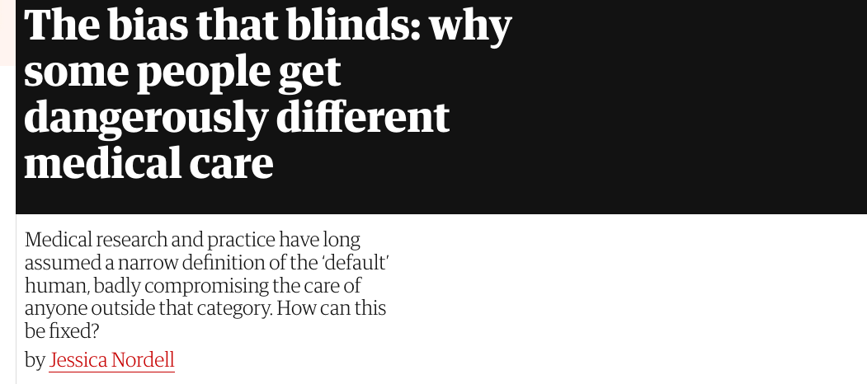
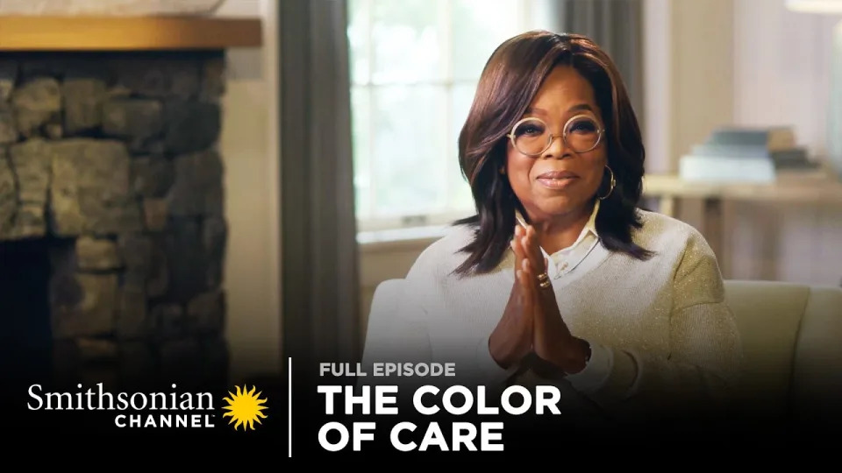
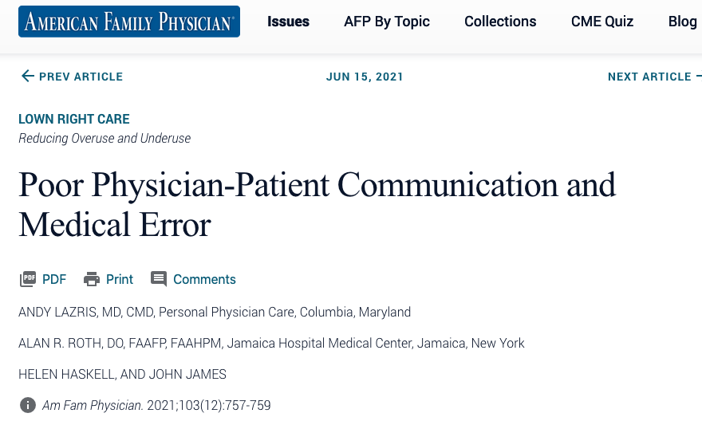
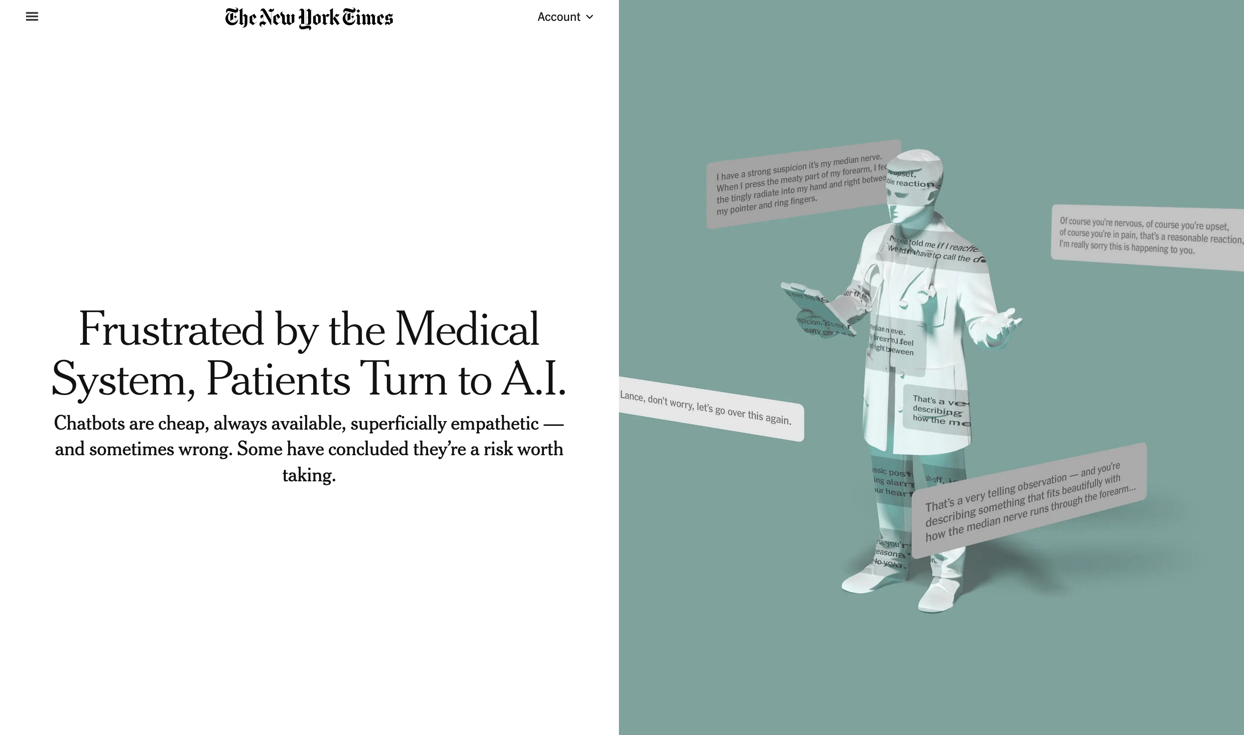
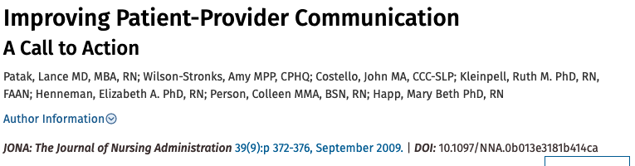


Slide 3
Conversational assistants for patients
Hypothesis: Addressing patients’ needs when accessing data / communicating with healthcare providers → better health outcomes
Notes:
There is lots of interdisciplinary research on all that I am presenting! I could fill slides and slides only with references. I will cite just few references and I apologize in advance if you don’t see your relevant work cited. Please talk to me

Slide 4
Conversational assistants for patients: A non-exhaustive list of challenges
Challenges:
Datasets: ecologically valid data. Often no data / small data / data not sharable
Computational models (AI/ML/NLP) must be:
informed by interdisciplinary insight: linguistics, psychology, health sciences
explanatory (no black-box models)
fair and not biased
Notes:
There is lots of interdisciplinary research on all that I am presenting! I could fill slides and slides only with references. I will cite just few references and I apologize in advance if you don’t see your relevant work cited. Please talk to me

Slide 5
Conversational assistants for patients: A non-exhaustive list of challenges (ctd)
Computational models:
LLMs (Large Language Models) are not there yet … if they will ever be:
Hallucinations, biases, opaqueness. How can we use them appropriately?
Are neuro-symbolic approaches the / one answer?
Evaluation: no SOTA (state-of-the-art) to beat; measure impact on real users / patients
Notes:
There is lots of interdisciplinary research on all that I am presenting! I could fill slides and slides only with references. I will cite just few references and I apologize in advance if you don’t see your relevant work cited. Please talk to me

Slide 6
Challenges Incarnated
Virtual Health Coach: support patients (and human
coaches) in adopting SMART goals via SMS exchanges
HFChat: conversational agent for Heart Failure patient
education

Slide 7
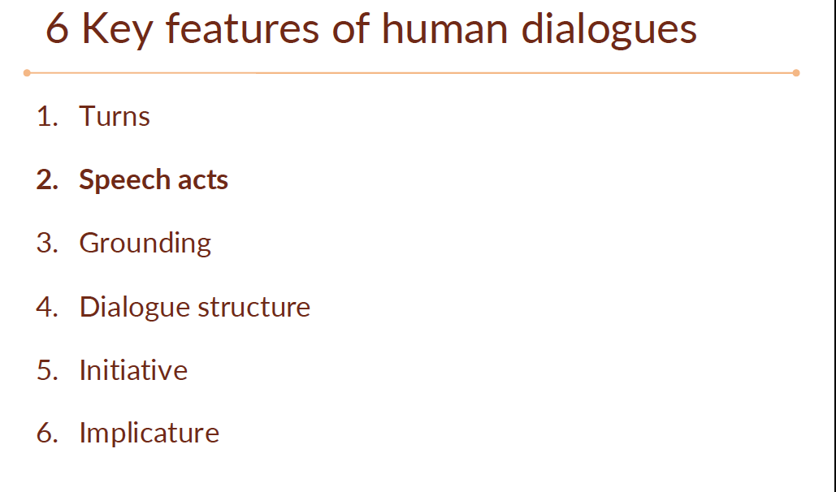
Riassunto- lezione 7 su dialogue systems & chatbots (Prof Mazzei)

Slide 8
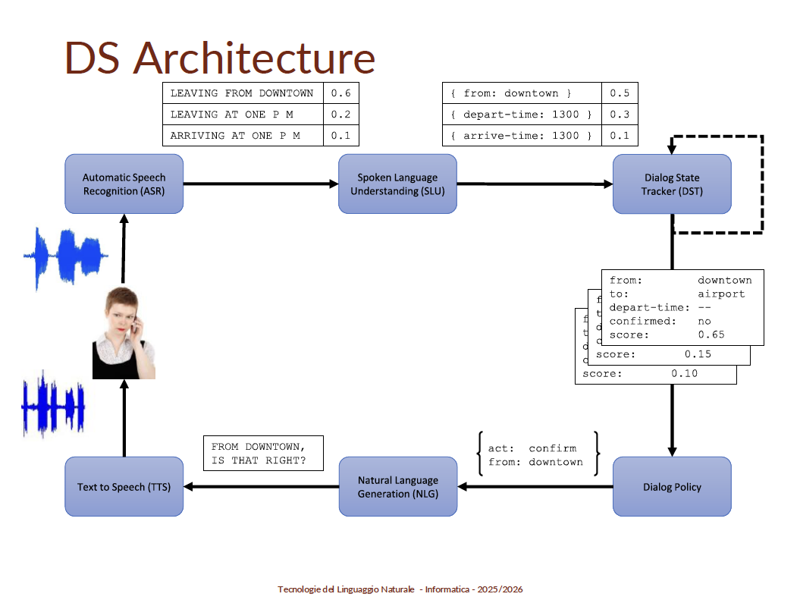

Slide 9
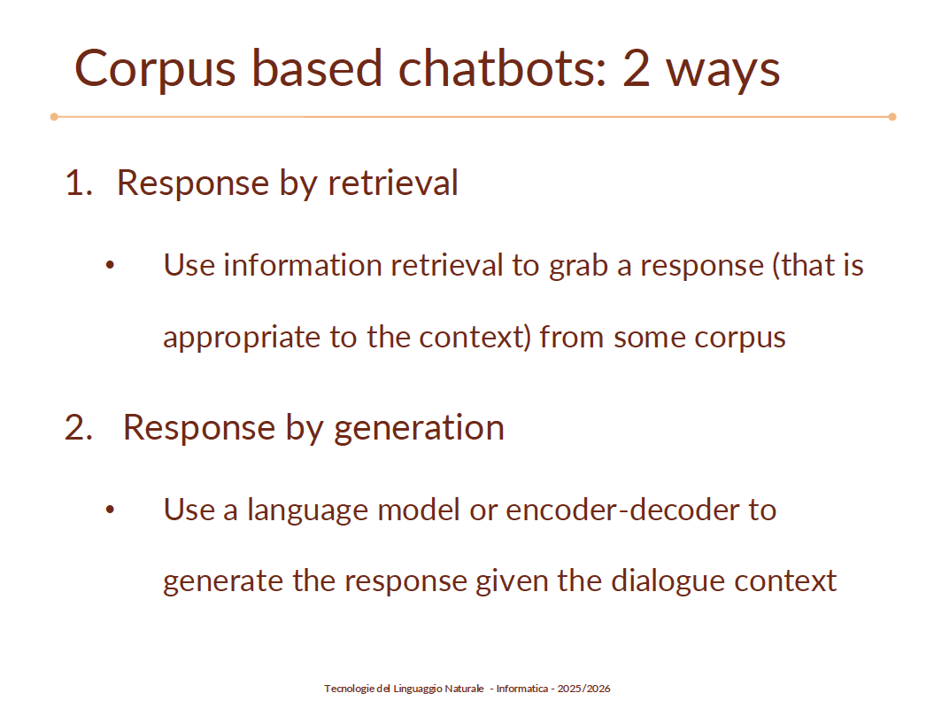
Chatbots: how do they answer?

Slide 10
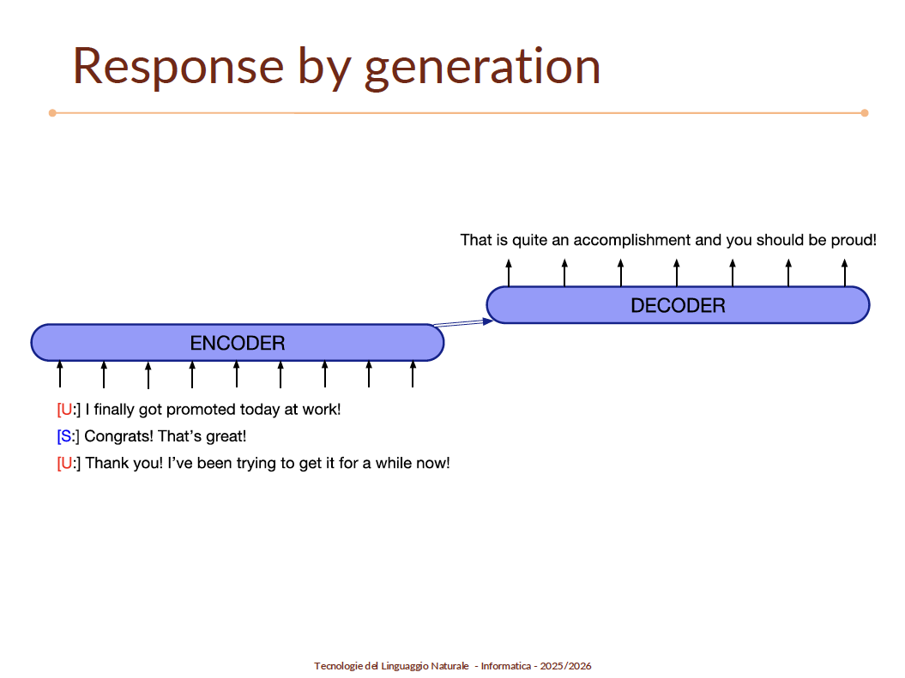

Slide 11
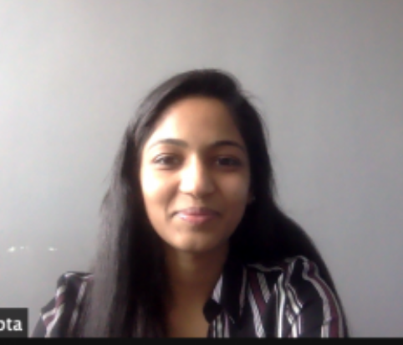

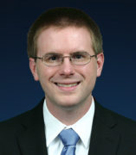

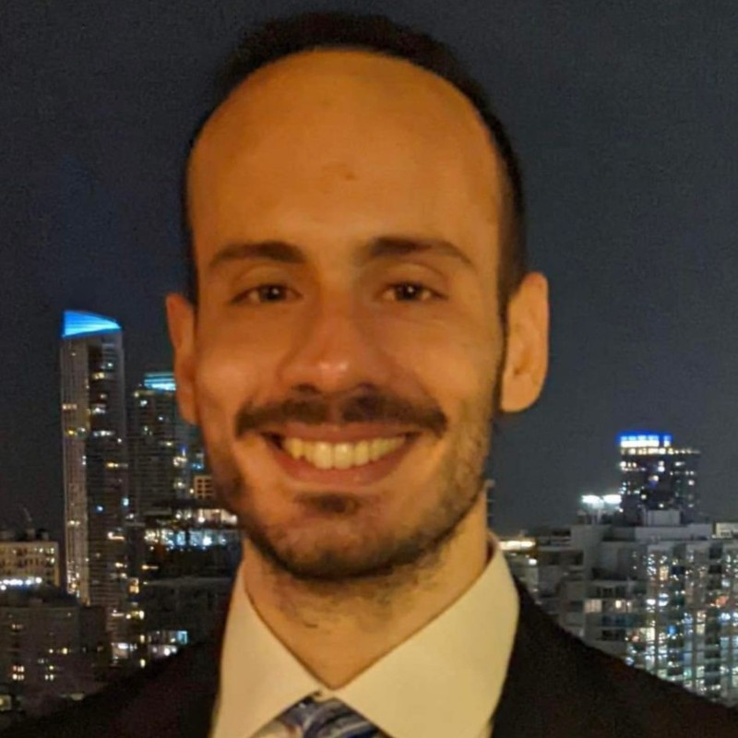


Virtual Health Coach (National Science Foundation 1838770, 2018-2025)
4 collaborators, 2 institutions, 2 colleges
3 PhD students
Notes:
Ben Gerber Umass
Sharp: Biobehavioral Nursing Science

Slide 12
Health Coaching
Health coach serves as advisor that provides ongoing support to clients as they set goals and make sustainable changes to improve their health [Kivelä et al., 2014]
Limitations of health coaching:
Expensive
Time-intensive
Inflexible
Limited reach based on travel
Waning interest with time
Notes:
Specific (S): Create a clear goal that is as specific as possible and focuses on a particular activity or task such as cycling, walking, or taking stairs.
Measurable (M): Quantify the goal to know when the goal has been accomplished.
Attainable (A): The goal should be attainable given the current situation such as workload and family responsibilities. The person should feel
confident towards accomplishing the goal.
Realistic (R): Set goals that are not too easy, but at the same time are not too hard. The goal should appear like a challenge but still be realistic.
In other words, it should be more challenging than the current average, but not too far off.
Time-Bound (T): Set an upper-bound time by which you want to achieve the goal. It is the higher level measurable component that is not
set regularly but instead is an overall time frame

Slide 13
Virtual Coach: Overall Research Question
How do we motivate people to adopt physically active lifestyle and help them maintain it long term in cost-effective way?
Dialogue-based virtual assistant health coach to interact via text messages and help increase physical activity by setting S.M.A.R.T. goals (Doran, 1981).
I will walk on my lunch break for 20 mins Wed and Thurs this week
Specific / Measurable / Attainable / Realistic / Time-bound
Intermediate step: support health coaches

Slide 14
Data Collection
 | Dataset 1 | Dataset 2
# health coaches | 1 | 3
# patients | 30 (28) | 28 (27)
Duration | 4 weeks | 8 weeks
Total # messages | 2853 | 4134
Coach/Patient messages | 54/46% | 58/42%
Activity tracker | Fitbit
Communication | MyTapp and SMS
Goal setting | Weekly SMART goals
De-identified dataset 2 available
https://github.com/uic-nlp-lab/virtualcoachdata
Notes:
We actually collected a third dataset too, but what will be presented based on this

Slide 15
What should dialogue agent do [to support coaches]?
Coach: Hi, hope you’re well. I forgot to message you yesterday to set your goal for Week 6, my apologies!
Coach: You met your goal 5 out of 7 days last week, great job What would you like to do for this week?
Patient: Gd morning, I am going to set the same goals. With a 7 confidence.
Dialogue agent should:
Summarize Goal: [activity] [location] [days] [time] …
Suggest next message to human coach
Notes:
Mention annotation for slots and stages and phases of goal setting – cannot discuss it, slide on it.

Slide 16
Text Messages Exchange Excerpt
Stage: Goal Setting
SMART Attributes: blue
---------------------------------Phase: Goal Identification-----------------------------------------
Coach: Think about this week, let’s call it week 1 of 4. Now what goal could you make that would allow you to do more walking (activity)?
Patient: I can take the stairs (activity) at work (location) for the work week.
------------------------------------Phase: Goal Refining--------------------------------------------
Coach: Sounds good. So will this be for coming, going and at lunch time (time)?
Patient: I will do at least twice (repetition) during workdays (days).
------------------------------------Phase: Anticipate Barrier---------------------------------------
Coach: On a scale of 1-10 with 10 being very sure and 1 not at all sure. How sure are you that you will accomplish your goal?
Patient: 9 (score)
Notes:
Shortened example

Slide 17
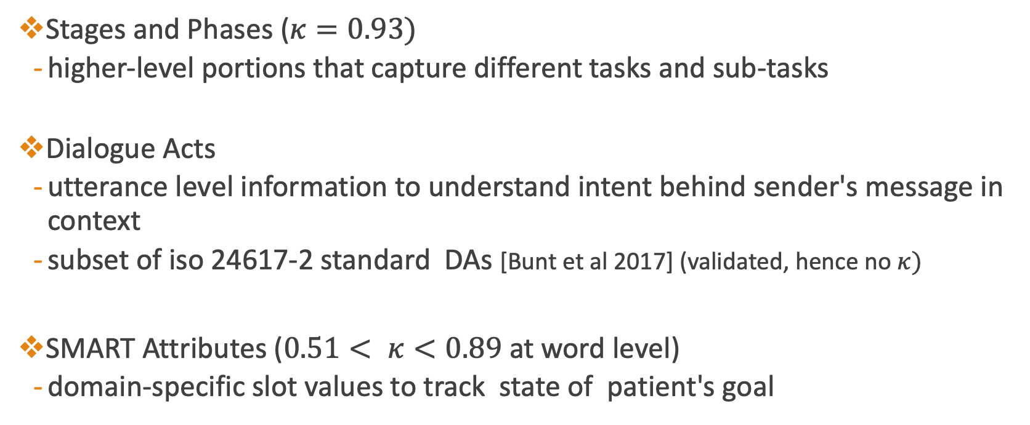
Three-Tier Dialogue Annotations
Stages and Phases ($κ=0.93)$
higher-level portions that capture different tasks and sub-tasks
Dialogue Acts
utterance level information to understand intent behind sender's message in context
subset of iso 24617-2 standard DAs [Bunt et al 2017] (validated, hence no $κ)$
SMART Attributes ($0.51< κ<0.89$ at word level)
domain-specific slot values to track state of patient's goal

Slide 18
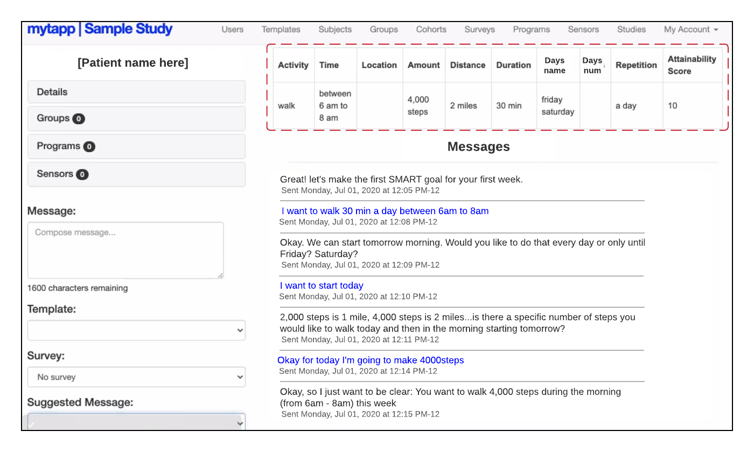
Interface with Summary

Slide 19
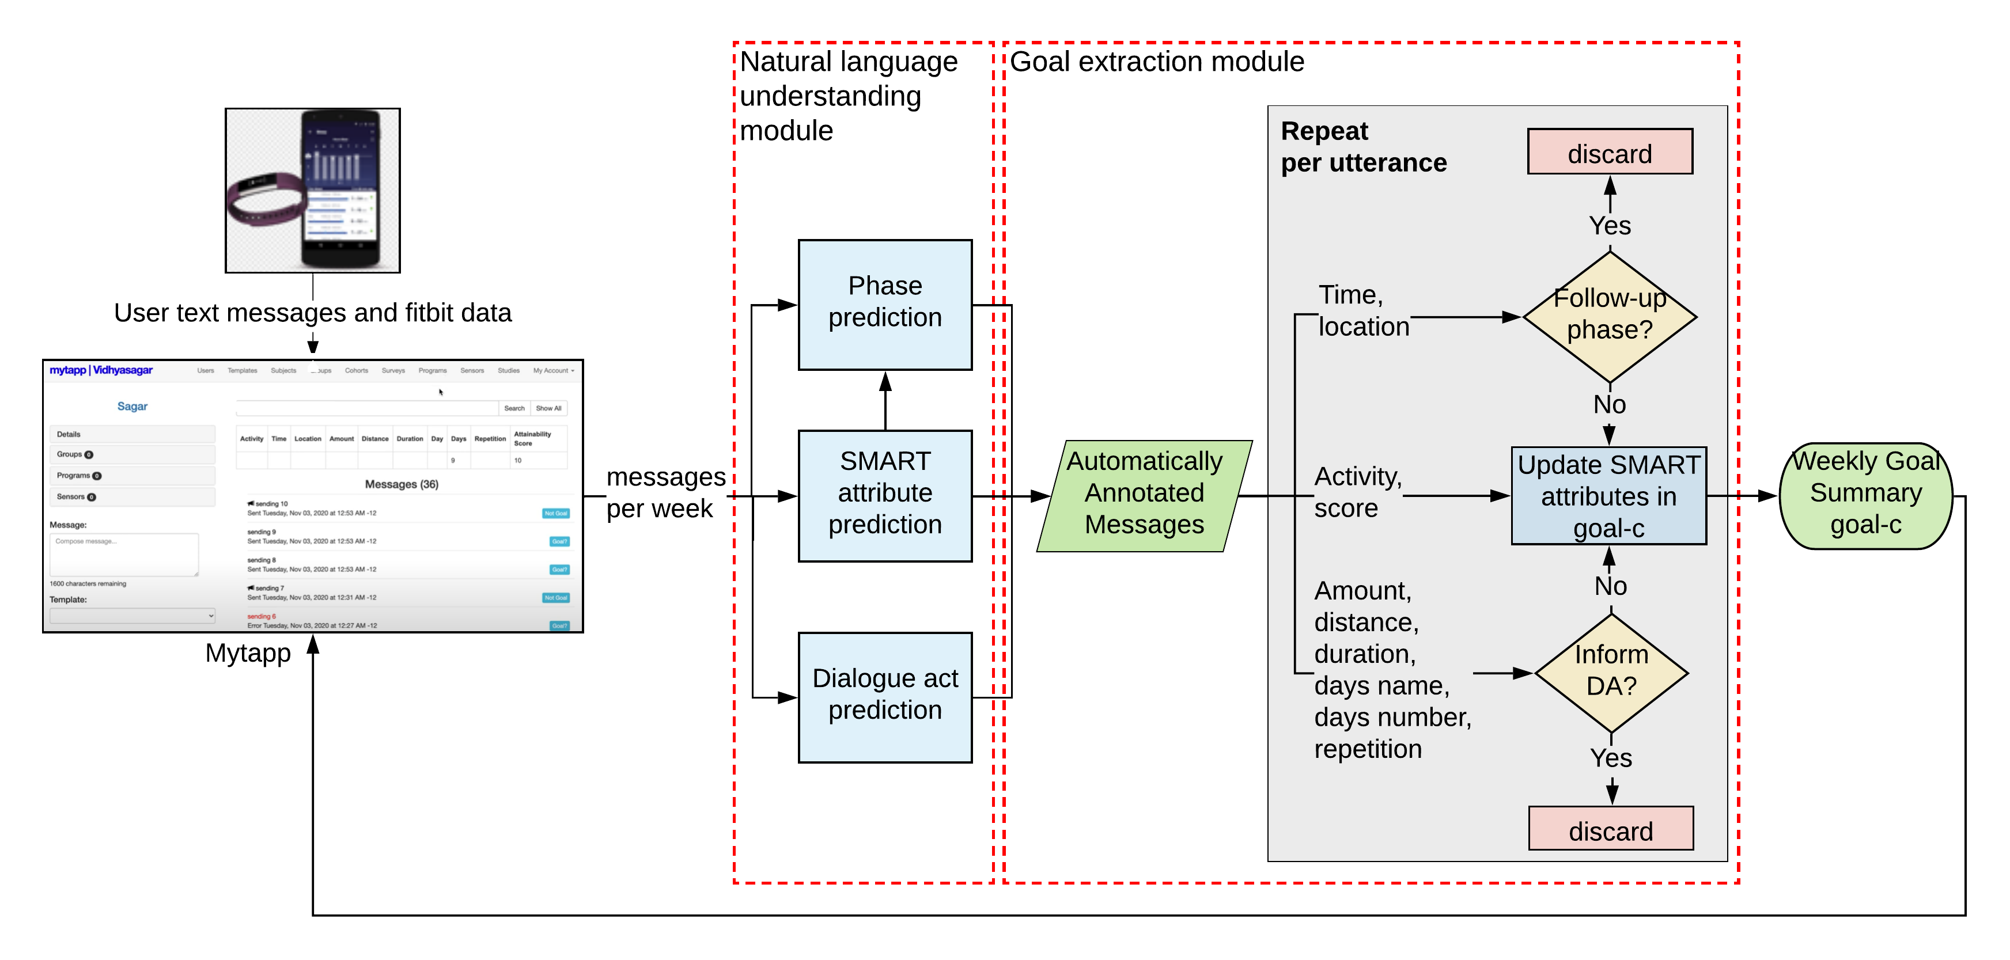
”Classic”: Goal Extraction Approaches [Gupta et al SigDIAL 20, 21]
1
2
3

Slide 20
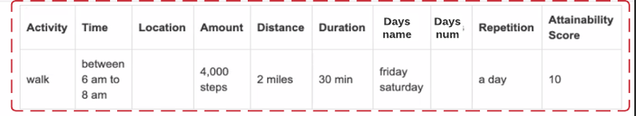
”Classic”: Goal Extraction Approaches [Gupta et al SigDIAL 20, 21]
Summarized goal with its 10 attributes:
Joint goal accuracy (all 10 attributes correct): 20%
No response generation

Slide 21
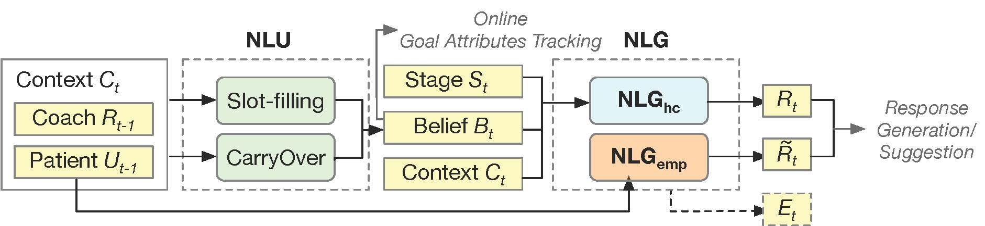
Neural architecture: summarize goal and generate response [Zhou et al COLING 22, COLING-LREC 24]
Notes:
$\text{Model} \text{architecture} \text{of} {NLG}_{hc} :$context $C_{t}$, belief tokens $B_{t}$, and predicted stage $S_{t}$ are concatenated as single input sequence, training with $T5$ encoder-decoder model [Reffel et al JLMR 2020]
Text-to-Text Transfer Transformer

Slide 22
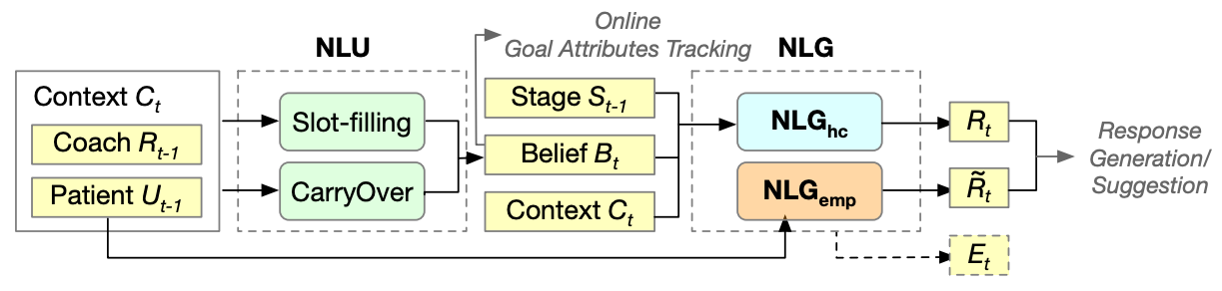
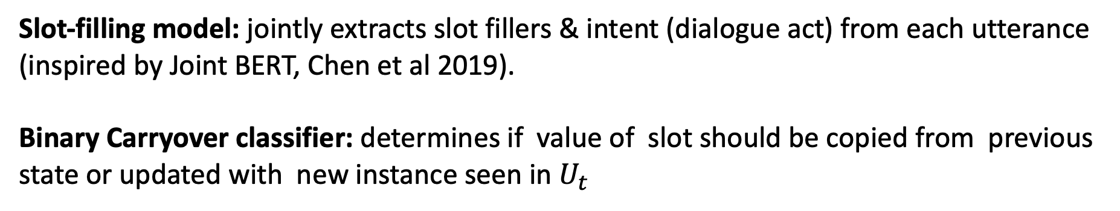
Neural NLU v1 [Zhou et al COLING 22]
Slot-filling model: jointly extracts slot fillers & intent (dialogue act) from each utterance (inspired by Joint BERT, Chen et al 2019).
Binary Carryover classifier: determines if value of slot should be copied from previous state or updated with new instance seen in $U_{t}$
Notes:
So the overall framework of our health coaching dialogue system can be summarized by this figure.. So the NLU module consist of two models: slot-filing and carryover classifier.
, which outputs a binary value for each slot.. By which we can keep track of belief states represented by slot value pairs

Slide 23
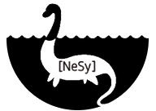
Neural NLU v2: Neurosymbolic AI
… aims to build rich computational AI models, systems and applications by combining neural and symbolic learning and reasoning. It seeks to complement the strengths of deep neural networks and symbolic AI while overcoming their respective weaknesses. https://nesy-ai.org/
Symbolic dialogue managers for Neural Networks [Xompero et al 2020, Zhang et al 2020]
Schema-driven control of NN end-to-end [Agrawal et al SigDIAL 24]
Deep logic programming approaches to dialogue architectures [Altszyler et al 2021, Zhou et al 2020]
Neurosymbolic AI
Workshop series (17 so far)
Notes:
Of course this idea is nto new – Resnik &

Slide 24
Neural NLU v2: Neurosymbolic approach [Zhou et al LREC-COLING 2024]
End-to-end neuro-symbolic workflow for goal summarization:
Neural: model trained to generate executable instruction (Copy {Days}) and to extract partial goal ("Walk 2,500 steps")
Symbolic: Then model edits partial goal on basis of previous goal and instruction
Notes:
avoids long input (N weeks’ dialogue) ; increases interpretability while requiring less data; no need for slot-filling scheme and annotation (but we wouldn’t be here without those earlier efforts)
For the goal summarizer, we use T5-base as the model backbone. To mitigate inefficient sampling, we manually annotate 40 positive examples, i.e., the sequences of instructions and partial goals that result in ground truth. The model was first finetuned with dialogue-to-goal pairs and then with the 40 examples we labeled. Finally, we contrast the sampled negative examples (the ones that fail) with
the positive examples to update the gradient.
List of instructions
" " Pass
Copy {Times} Copy times, e.g., “after 8 pm”
Copy {Days} Copy days, e.g., “Mon-Fri”
Copy {Num} Copy number, e.g., “3000 steps”
Add {Num} Add number from previous goal.
Add {Days} Add days from previous goal.
Copy {All} Copy all info from previous.

Slide 25
Virtual Coach: NLU Results
Joint Goal Accuracy (10 attributes all correct):
Classic [Gupta et al SigDIAL 21] | 20%
Neural NLU v1 [Zhou et al COLING 22] | 21.7%
Neural NLU v2 [Zhou et al LREC-COLING 24] | 52.8%

Slide 26
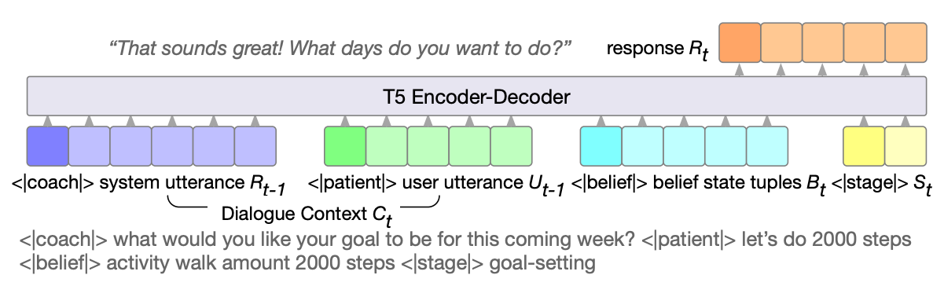
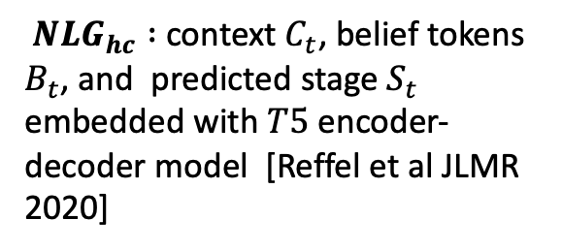
NLG: generate response [Zhou et al COLING 22]
${NLG}_{hc} :$context $C_{t}$, belief tokens $B_{t}$, and predicted stage $S_{t}$ embedded with $T5$ encoder-decoder model [Reffel et al JLMR 2020]
Notes:
$\text{Model} \text{architecture} \text{of} {NLG}_{hc} :$context $C_{t}$, belief tokens $B_{t}$, and predicted stage $S_{t}$ are concatenated as single input sequence, training with $T5$ encoder-decoder model [Reffel et al JLMR 2020]
Text-to-Text Transfer Transformer

Slide 27

Generate empathetic responses [Zhou et al COLING 22]
Following Sharma et al. (2020), empathetic response based on three communication mechanisms:
Emotional Reactions [EMOR]: “I would be very worried”
Interpretations [INTER]: “I know anxiety is scary”
Explorations [EXPL]: “What happened? How come?”
Notes:
Emotional reaction expresses direct emotions (e.g., compassion) to show empathy, such as "I would be very worried."
Interpretation communicates an understanding of the speaker’s experience, such as "I know anxiety is scary." Exploration expresses empathy by exploring the speaker’s feelings, such as "What happened? How come?"
We seek to use the mechanism signals to control the style of the generated empathetic response, making it flexible and appropriate for health coaching scenarios

Slide 28
Generate empathetic responses [Zhou et al COLING 22]
BERT-based classifier for emotion detection in patient’s utterance
Train GPT2 to generate empathetic responses, given communication mechanism token [EMOR] & patient utterance
<|bos|> [EMOR] I was so exhausted yesterday. <|sep|> That’s understandable. Take some rest! <|eos|>
(Patient utterance)
(Empathetic response)
Notes:
Emotional reaction expresses direct emotions (e.g., compassion) to show empathy, such as "I would be very worried."
Interpretation communicates an understanding of the speaker’s experience, such as "I know anxiety is scary." Exploration expresses empathy by exploring the speaker’s feelings, such as "What happened? How come?"
We seek to use the mechanism signals to control the style of the generated empathetic response, making it flexible and appropriate for health coaching scenarios
We utilized two benchmark empathetic dialogue datasets: (i) EMPATHETICDIALOGUES
(ED) (Rashkin et al., 2019) and (ii) EPITOME. EMPATHETICDIALOGUES (ED) is a open-domain empathetic dialogue dataset containing 24,850 dialogues, with each dialogue
grounded in one of 32 emotional context (e.g., proud, apprehensive, confident, guilty). EPITOME (Sharma et al., 2020) is an empathetic dataset in mental health support settings. The dataset consists of 3k posts annotated with respect to the communication mechanisms (Emotional Reaction, Exploration, Interpretation) and level of empathy (from 0 to 2, representing no empathy, weak and strong
empathy, respectively) in each mechanism.
Finetuned on 64 virtual coach dialogues
a BERT-based multi-class
classifier to predict the emotion signals of the patient’s
utterance.

Slide 29
Examples of empathetic responses
Coach: Good morning! How is your goal for the week going?
Patient: I am sorry I didn’t go to work today I have a massive migraine headache
[EMOR] oh no I hope you are OK
[EXPLOR] Oh geez, sorry to hear that. Are you feeling better?
[INTERP] I’ve had this experience before. Sometimes it really hits you

Slide 30
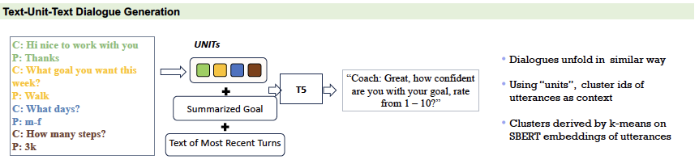
NLG: Text-Unit-Text generation [Zhou et al LREC-COLING 24]

Slide 31
And what about LLMs? [Zhou et al LREC-COLING 24]
GPT-3.5-turbo: two-shot in-context exemplars due to input context limit
Prompt: As a health coach, your task is to refine the patient’s goal into a SMART goal. Ask for details like frequency, time, duration, location, and confidence level, but only one aspect at a time. After establishing the goal, monitor the patient’s progress and keep them engaged. Always address their concerns concisely. Now, consider the following dialogue context and formulate your response: …

Slide 32
Response examples
Coach: Hi [Name], hope you’re well. I forgot to message you yesterday to set your goal for Week 6, my apologies!
Coach: You met your goal 5 out of 7 days last week, great job. What would you like to do for this week?
Patient: Gd morning [Name], I am going to set the same goals. With a 7 confidence.
a) Zhou et al. (2022): That’s great. And think about what activity would you like to set for your goal? Walks, stairs, etc
b) Zhou et al. (2024): Ok, great! Can you think of any barriers that might prevent your goal?
c) GPT-3.5-turbo: That’s fantastic to hear that you’re sticking to your goals! Let’s make sure it’s a SMART goal
for Week 6. Can you provide more details about the goal, like the specific number of steps or any changes in
frequency, time, or location?
Notes:
What do you think? Which one do you prefer?

Slide 33
Human Evaluation
45 nursing students evaluated several contexts + their respective generated responses: about 900 total items, about 20/student
Responses: only [Zhou et al COLING-LREC 24]
<no edits, minor edits, major edits>
<irrelevant, harmful,incoherent>
Notes:
"There will be approximately 30 proposed messages in each session requiring 20-30 minutes to complete. You can complete up to 3 sessions. However, you will be given the opportunity to indicate if they would like to complete a 2nd or 3rd session after each session. You may decide how many you wish to complete" (from consent form)

Slide 34
Response Analysis
No harmful or incoherent responses

Slide 35
Virtual Coach: Take aways
Dataset: collected dataset, partially sharable
Developed neurosymbolic approach, highest performance
LLMs: qualitatively, GPT-3.5 answers were incomplete / incoherent
Evaluation: ran user study with nursing students

Slide 36
Additional slides

Slide 37
NLG [Zhou et al COLING 22]
Context $C_{t}$, belief tokens $B_{t}$, and predicted stage $S_{t}$ embedded with $T5$ encoder-decoder model [Reffel et al JLMR 2020]
Notes:
$\text{Model} \text{architecture} \text{of} {NLG}_{hc} :$context $C_{t}$, belief tokens $B_{t}$, and predicted stage $S_{t}$ are concatenated as single input sequence, training with $T5$ encoder-decoder model [Reffel et al JLMR 2020]

Slide 38
References
I. Gupta, B. Di Eugenio, B. Ziebart, A. Baiju, B. Liu, B. Gerber, L. Sharp, N. Nabulsi, and M. Smart. Human-human health coaching via text messages: Corpus, annotation, and analysis. In Proceedings of the 21th Annual Meeting of the Special Interest Group on Discourse and Dialogue, pages 246–256, 1st virtual meeting, July 2020. Association for Computational Linguistics.
I. Gupta, B. Di Eugenio, B. Ziebart, B. Liu, B. Gerber, and L. Sharp. Goal summarization for human-human health coaching dialogues. In The Thirty-Third International FLAIRS Conference, 2020.
I. Gupta, B. Di Eugenio, B. D. Ziebart, B. Liu, B. S. Gerber, and L. K. Sharp. Summarizing behavioral change goals from SMS exchanges to support health coaches. In Proceedings of the 22nd Annual Meeting of the Special Interest Group on Discourse and Dialogue, pages 276–289, 2021.
Gupta, Itika, Barbara Di Eugenio, Devika Salunke, Andrew Boyd, Paula Allen-Meares, Carolyn Dickens, and Olga Garcia. "Heart failure education of African American and Hispanic/Latino patients: Data collection and analysis." In Proceedings of the First Workshop on Natural Language Processing for Medical Conversations, pp. 41-46. 2020.
Mac, O., et al . (2022). Comparison of Readability Scores for Written Health Information Across Formulas Using Automated vs Manual Measures. JAMA Network Open, 5(12)
C. Raffel, N. Shazeer, A. Roberts, K. Lee, S. Narang, M. Matena, Y. Zhou, W. Li, and P. J.Liu. Exploring the limits of transfer learning with a unified text-to-text transformer. Journal of Machine Learning Research, 21(140):1–67, 2020.
Su, Y., Shu, L., Mansimov, E., Gupta, A., Cai, D., Lai, Y.-A., and Zhang, Y.: Multi-task pre-training for plug-and-play task-oriented dialogue system. In Proceedings of the 60th Annual Meeting of the Association for Computational Linguistics (Volume 1: Long Papers), eds. S. Muresan, P. Nakov, and A. Villavicencio, pages 4661–4676, Dublin, Ireland, May 2022. Association for Computational Linguistics.

Slide 39
References (ctd)
Tayal, Anuja, Barbara Di Eugenio, Devika Salunke, Andrew Boyd, Carolyn A. Dickens, Eulalia P. Abril, Olga Garcia-Bedoya, and Paula G. Allen-Meares. "A neuro-symbolic approach to monitoring salt content in food." In Proceedings of the First Workshop on Patient-Oriented Language Processing (CL4Health)@ LREC-COLING 2024, pp. 93-103. 2024.
Y. Zhou, B. Di Eugenio, B. Ziebart, L. Sharp, B. Liu, B. Gerber, N. Agadakos, and S. Yadav. Towards enhancing health coaching dialogue in low-resource settings. In Proceedings of the 29th International Conference on Computational Linguistics, pages 694–706, Gyeongju, Republic of Korea, Oct. 2022. International Committee on Computational Linguistics.
Y. Zhou, B. Di Eugenio, B. Ziebart, L. Sharp, B. Liu, and N. Agadakos. Modeling lowresource health coaching dialogues via neuro-symbolic goal summarization and text-units text generation. In N. Calzolari, M.-Y. Kan, V. Hoste, A. Lenci, S. Sakti, and N. Xue, editors, Proceedings of the 2024 Joint International Conference on Computational Linguistics, Language Resources and Evaluation (LREC-COLING 2024), pages 11498–11509, Torino, Italia, May 2024. ELRA and ICCL.
Y. Zhou, B. Di Eugenio, and L. Cheng. Unveiling performance challenges of large language models in low-resource healthcare: A demographic fairness perspective. In O. Rambow, L.Wanner, M. Apidianaki, H. Al-Khalifa, B. D. Eugenio, and S. Schockaert, editors, Proceedings of the 31st International Conference on Computational Linguistics, pages 7266–7278, Abu Dhabi, UAE, Jan. 2025. Association for Computational Linguistics.
Y. Zhou and B. Di Eugenio. Veracity bias and beyond: Uncovering LLMs’ hidden beliefs in problem-solving reasoning. In W. Che, J. Nabende, E. Shutova, and M. T. Pilehvar, editors, Proceedings of the 63rd Annual Meeting of the Association for Computational Linguistics (Volume 1: Long Papers), pages 21298–21310, Vienna, Austria, July 2025. Association for Computational Linguistics.

